Slide 1
Welcome
ADR Address of the
Supreme Court of New South Wales

Slide 2
Prof Luke Nottage PhD, LLD
ADR Address of the
Supreme Court of New South Wales
Presented By

Slide 3
Cross-fertilisation in International Commercial Arbitration, Investor-State Arbitration & Mediation: The Good, the Bad & the Ugly?

Slide 4
Overview
Introduction
The Explosion in International Arbitration [ICA then ISA]
The Resurgence of Costs and Delays [in both fields of IA]
The Fall of Arb-Med [i.e. with same neutral]
The Rise of Multi-tiered Dispute Resolution Clauses
[different neutrals: e.g. mediation before arbitration]
Conclusions

Slide 5
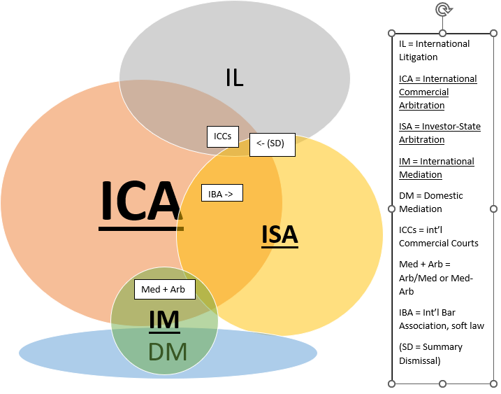
1. Introduction
ADR and litigation are part of an overall system
For international DR, much discussion on interface or cross-fertilisation between IL & ICA
Focus here more on ICA & ISA i.e. foreign investors arbitrating vs host states, usually now under BITs or FTAs with home states (aka ISDS)
Plus interface with IM (limited, but pushed also by DM)
Arb-Med with same neutral
Med-Arb with different neutrals

Slide 6
2. The Explosion in International Arbitration (IA)
Underpinned by the 1958 New York Convention
Art II stay of litigation: kickstarts the (foreign-seated) IA, i.e. first phase
Art V enforcement of awards (with limited exceptions … not: error of substantive law): regulates the last phase
Australia ratified in 1975 (Singapore 1986)
And by the UNCITRAL Model Law (1985, rev’d 2006 for interim measures)
Drawing on NYC concepts and especially (opt-in) 1976 UNCITRAL Arbitration Rules, to regulate especially the middle phase at ICA seat
Australia quite quick to adopt, in 1989 like HK (Singapore 1994), then 2010-17 as core also for domestic arbitrations
But still struggles to attract many ICA cases!

Slide 7
Spread “East” of ICA especially over last 20 years (Reyes & Gu ‘18):
Adopting first NYC, then ML
Emergence of pro-arbitration case law
e.g. narrowing ‘public policy’ objection to awards, so ‘deference’ to arbitrators’ rulings on procedure: US/UK → HK → Singapore → Australia (in: Ferrari & Rosenfeld eds, Kluwer ‘23)
At least one dedicated IA institution
or several, in PRC; cf India (ad hoc arbs)
e.g. ACICA from ‘85 in Melbourne (rebooted in Sydney)
SIAC → HKIAC, (KLRCA rebooted as) AIAC, KCAB, VIAC
Other supportive ‘infrastructure’ (including university-level & professional training)
2. The Explosion in International Arbitration (IA) cont’d

Slide 8
Gradual increase in ISA involving Asian parties
More treaties, with full advance consent (e.g. PRC, Thailand) + more FDI = disputes
Fewer “institutional barriers” (e.g. local experts), but not all ratify 1965 ICSID Convention
2. The Explosion in International Arbitration (IA) cont’d

Slide 9
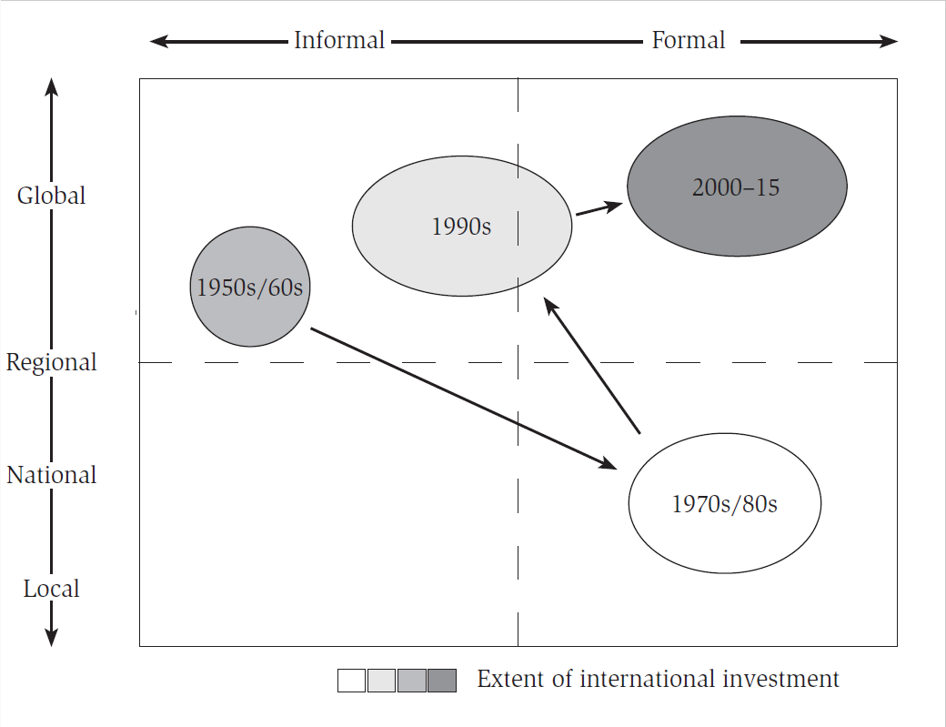
YET: 3. Resurgent Costs and Delays
Déjà vu? Like 70s-80s, leading from mid-1990s to some countermeasures (eg Rules reforms, revised Model Law)
But resurgent costs & delays this century not so obviously driven by national (Anglo-American) litigation style, as IA is more global

Slide 10
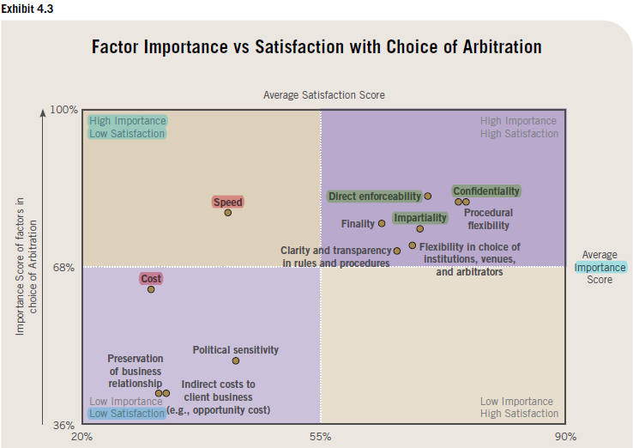
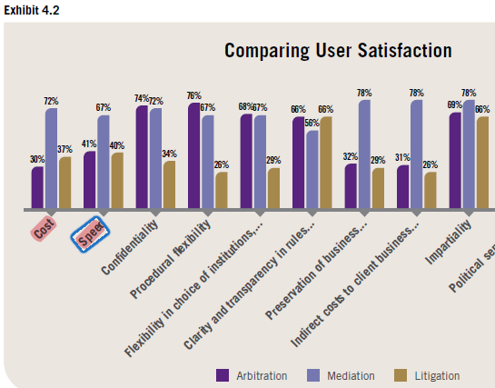
Eg Singapore International Dispute Resolution Academy (SIDRA) Survey 2022:
¾ external lawyers (39% Singapore), ¼ internal lawyers or executives (57%)
https://sidra.smu.edu.sg/research-program/international-dispute-resolution-survey/sidra-survey-2022

Slide 11
So: what now drives IA costs and delays?
Transactions hence disputes are indeed more complex:
e.g. multi-party/contracts: IA does struggle to address these as rooted in consent (Garnett ‘23 MULR)
BUT also:
IA has no real competitor (especially ICA): NYC provides worldwide enforceability of rulings
c.f. even the new Int’l Comm Courts, or 2019 Singapore Mediation Convention (few ratifications)
Expansion of (large) law firms, especially ‘billable hours’ model

Slide 12
Conservatism around controls over legal fees: cf eg
Absolute caps based on dispute amount? (IAMA ‘14 = RI ‘16, no more!)
Calderbank ‘sealed offers’? Little practice/encouragement
Confidentiality & IBA ‘soft’ law?
Double-edged swords (especially now ICA influencing ISA)
Some pushback, e.g. Swiss Arb Association, Prague Rules ‘18, JCAA Interactive Arb Rules ‘19

Slide 13
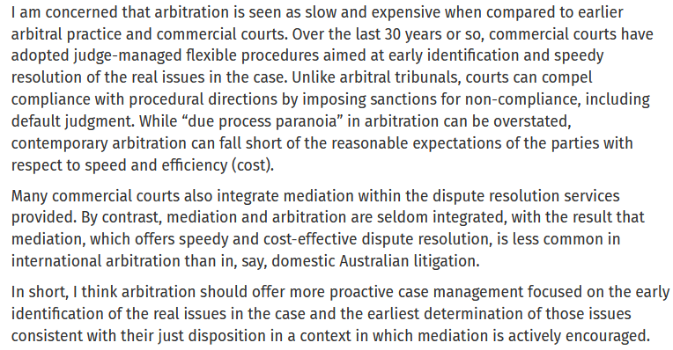
https://arbitrationblog.kluwerarbitration.com/2023/10/10/interviews-with-our-editors-in-conversation-with-the-hon-wayne-martin-ac-kc/

Slide 14
4. The Fall of Arb-Med
As ICA spread East, the practice of the arbitrator acting as mediator attracted interest (notably, still, in PRC): efficiencies?
But concerns, especially if ‘caucusing’, over equal treatment and neutrality - led to e.g.:
… HK in ‘89 → Singapore ’94 adding that if mediation fails, arbitrator must disclose material information received in confidential caucusing
Yet not used! So from ‘15 SIMC/SIAC Arb-Med-Arb, with separate neutrals

Slide 15
CAA (NSW) 1990 innovation also not used, so 2010 revision adds above plus requirement of second consent by parties if mediation fails – still not used?
ACICA Arb Rules draft had similar model (plus ‘back-up arbitrator’): not adopted
Japan adds practice of parties agreeing neutral will not use material information in award, but doesn’t actively advertise Arb-Med (nor Korea)

Slide 16
5. The Rise of Med-Arb etc.
Instead, growing use of multi-tiered DR clauses (e.g. QMUL surveys)
Although regional variance: less in international contracts involving e.g. parties from Korea, Japan, China … more if from the common law jurisdictions in Asia
more costs/lawyers leads to courts/legislatures promoting ADR domestically, so commercially supplied mediation services / familiarity grow? But not eg India
This may also explain few ratifications of 2019 Singapore Mediation Convention

Slide 17
Also still rare for mandatory mediation before arbitration in ISDS
e.g. unusually in Australia-Indonesia FTA and HK-UAE BIT, but NOT in Australia-HK BIT, all signed in 2019: with Ana Ubilava et al via https://arbitrationblog.kluwerarbitration.com/author/luke-nottage/
Anyway, ISA tribunals have discussed whether pre-arb good faith negotiations step compliance goes to jurisdiction of tribunal (pre-condition to arb) or admissibility of the claim
If former, courts decide & non-compliance may lead to award annulment
If latter (mostly), error of law so not reviewable by courts etc.

Slide 18
Influencing (?) debate now in domestic courts:
IRC 2012 SGHC suggested usually pre-condition (so jurisdictional), but recent doubts
C v D 2023 HKFCA presumed usually not (so arbitrator determines admissibility), seen as ‘pro-arbitration’ … but is this ‘anti-mediation’?
Arguably should depend on: wording, type of pre-arb steps, when issue arises (stays vs awards), how widespread is ADR?

Slide 19
6. Conclusions
ICA and then ISA have grown, spreading from West to East, with arbitrators, counsel and others moving between the fields
But costs and delays remain problematic in IA
So ISM is emerging, but especially for commercial disputes, in jurisdictions with high litigation costs hence privately-supplied domestic mediation; NOT yet for ISDS involving foreign investors
Some cross-overs among ICA, ISA and ISM (all influenced by domestic litigation and DR) may be more productive than others, as with some interfaces with international litigation

Slide 20
Further reading:
Nottage, International Commercial and Investor-State Arbitration – Australia and Japan in Regional and Global Contexts (Elgar 2021)
https://japaneselaw.sydney.edu.au/2020/08/book-in-press-with-elgar/
Including eg: ‘A Weathermap for International Arbitration: Mainly Sunny, Some Cloud, Possible Thunderstorms’ (2015) 26 ARIA 496,
and ‘In/Formalisation and Globalisation of International Commercial Arbitration and Investment Treaty Arbitration in Asia’ in Zekoll et al eds, Formalisation and Flexibilisation in Dispute Resolution (Brill 2014)
Those and others via http://ssrn.com/author=488525
Nottage et al (eds) New Frontiers in Asia-Pacific International Arbitration and Dispute Resolution (Wolters Kluwer 2021)
Reyes & Gu (eds), Multi-Tier Approaches to the Resolution of International Disputes (CUP 2022)

